Slide 1
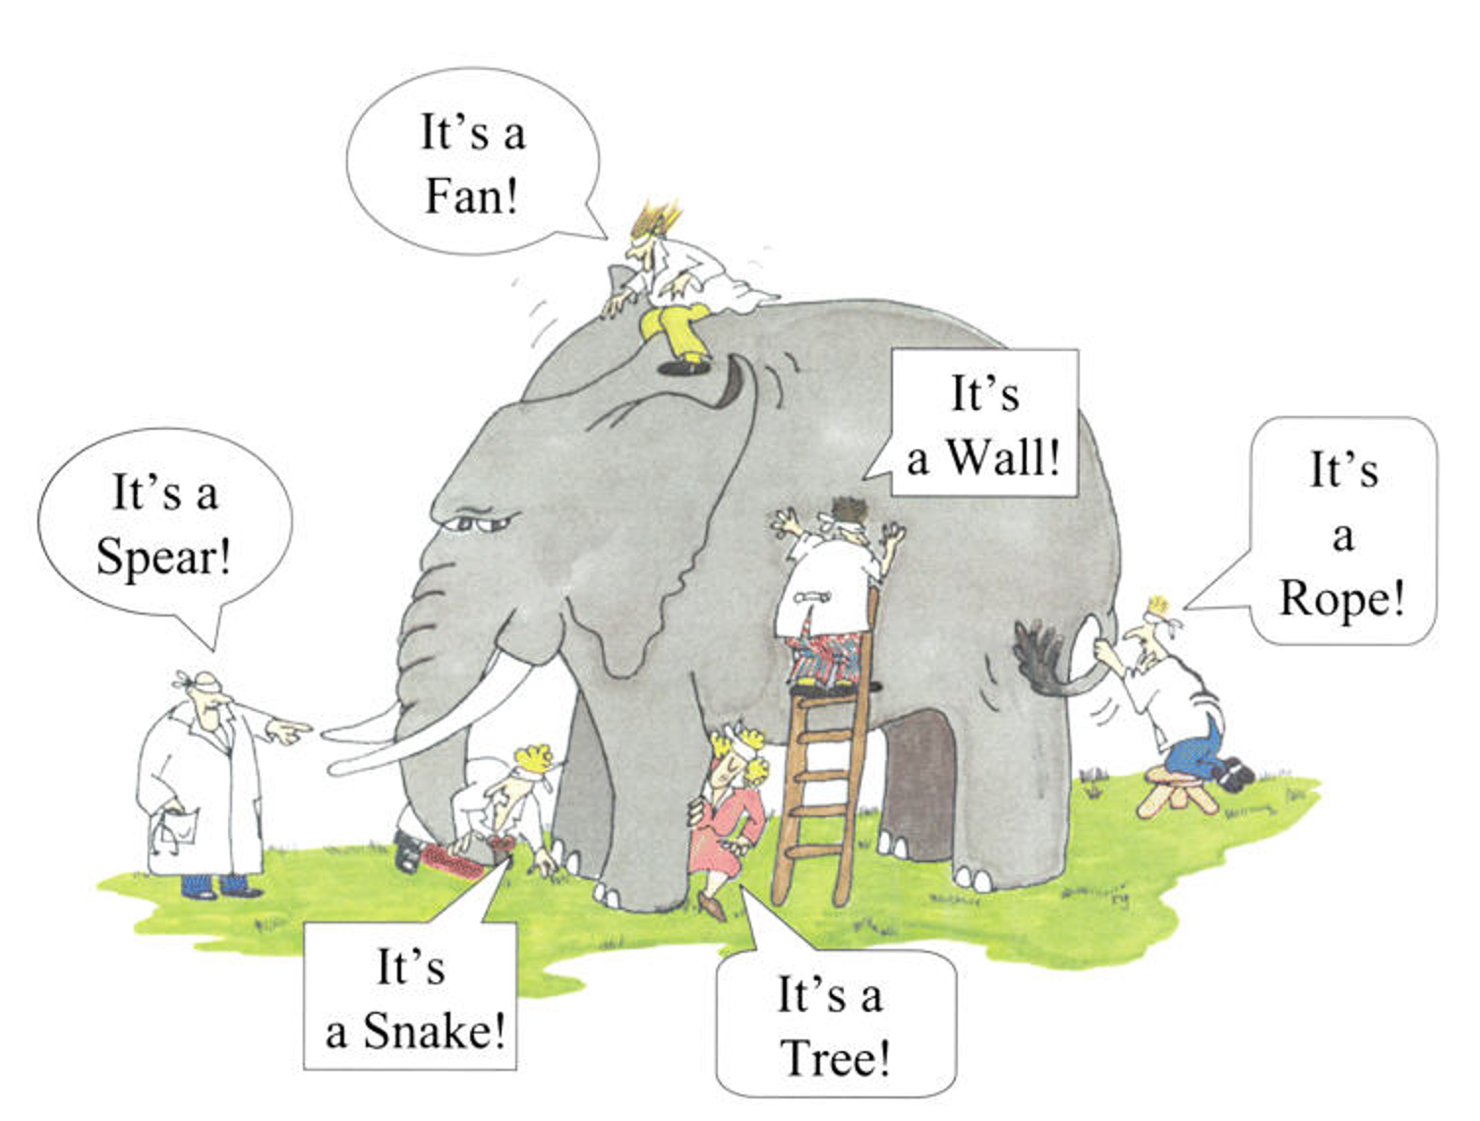
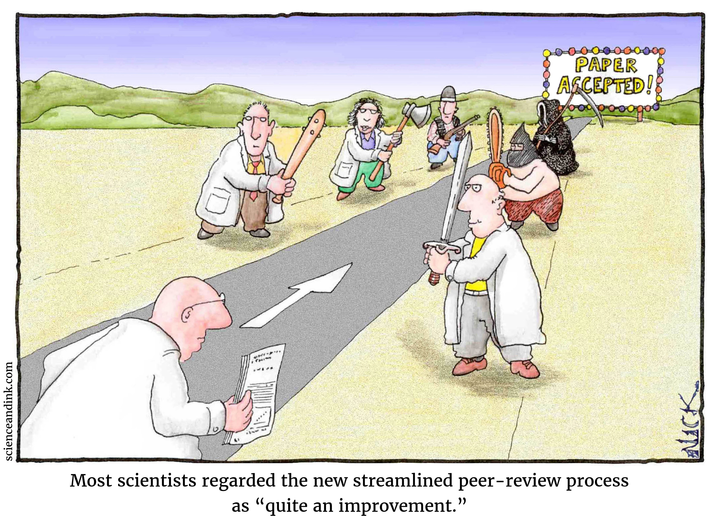
Why become a reviewer?
Gatekeeper? Knowledge promoter? Resource for authors?

Slide 2
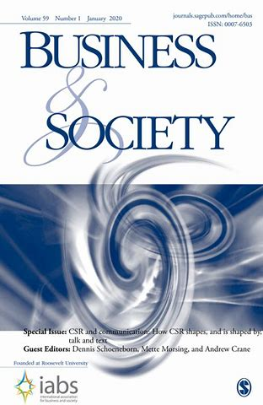
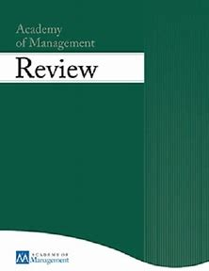
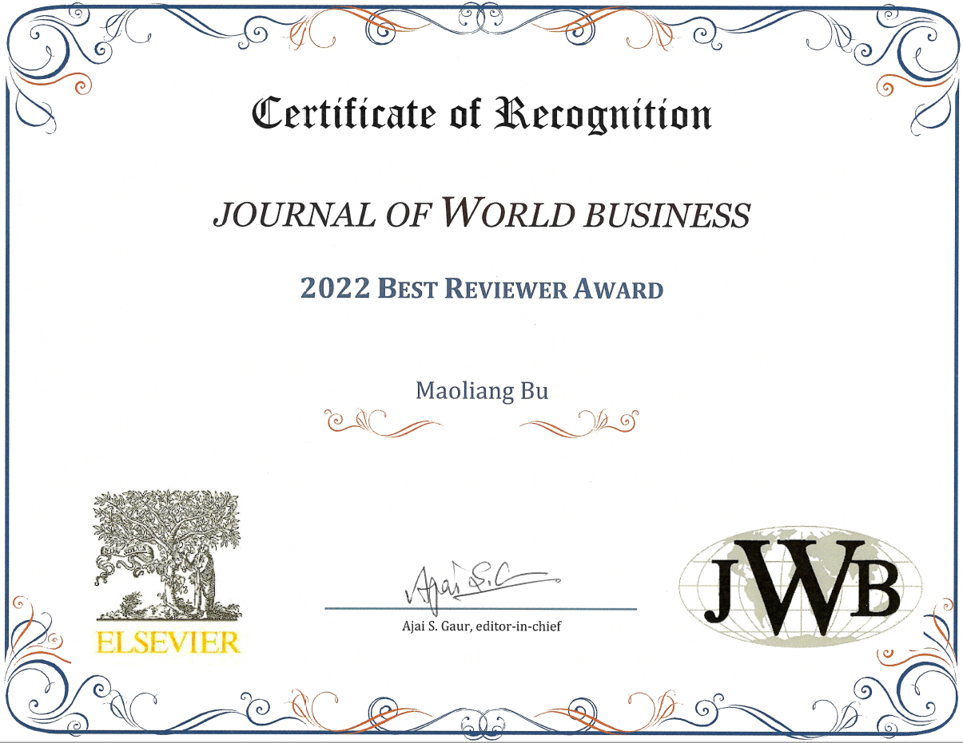
Why become a reviewer?
Service -> Learning -> Scholarship

Slide 3
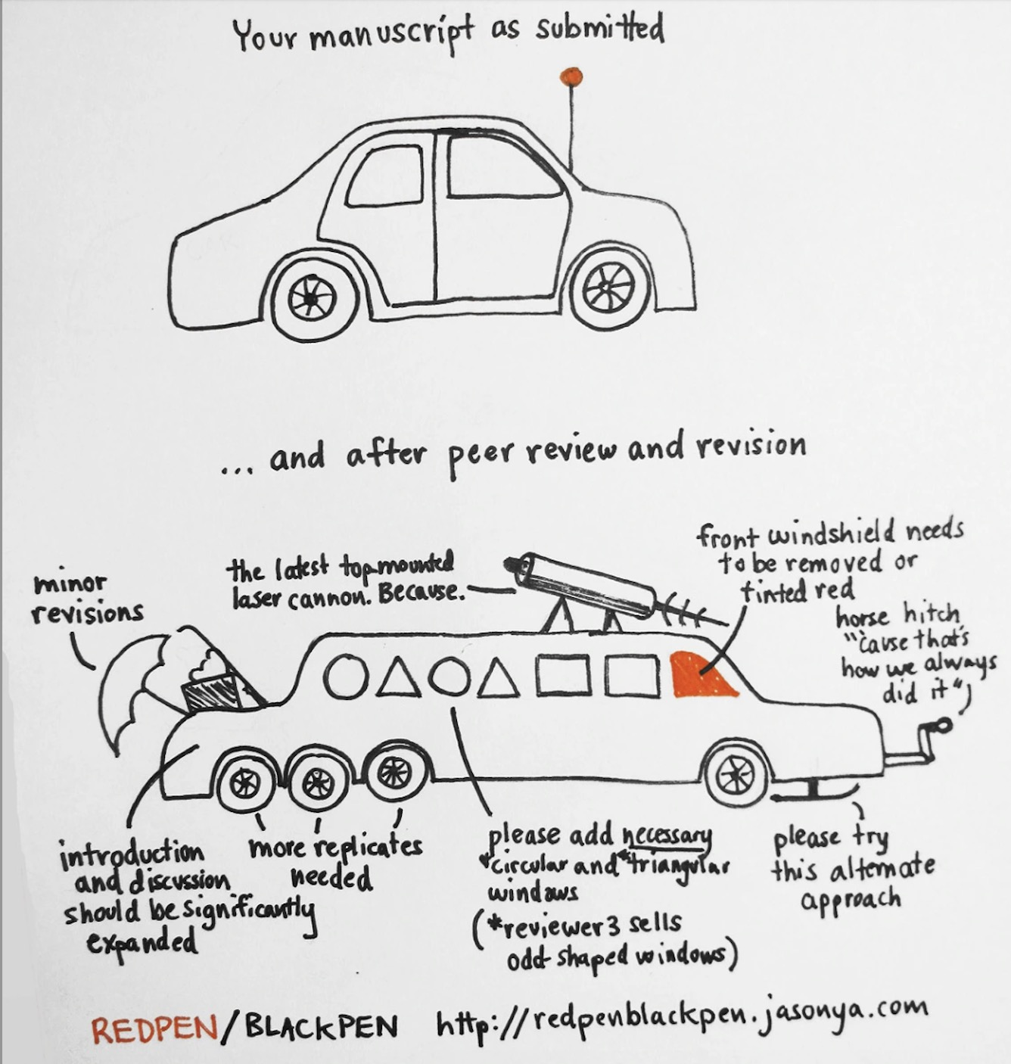
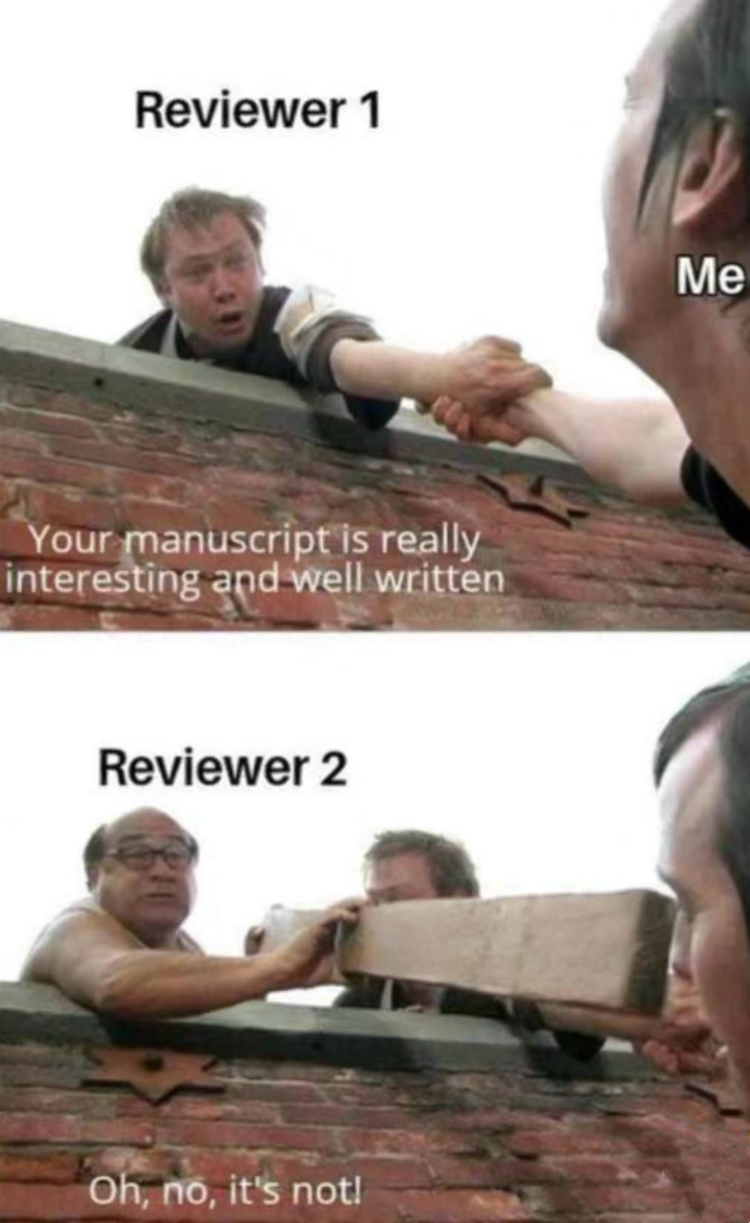

Slide 4
Four actionable guidelines to help reviewers become great reviewers
1. Assess critically the quality of theory development, including theory borrowing from outside of the field of study
2. Put effort into recognizing where the paper has gone ‘beyond the state-of-the-art’
3. Assess critically, but with an open mind and as an authors’ resource, whether the common standards of methodological rigor have been respected
4. Give a chance to the analysis of frontier phenomena
Verbeke A, Von Glinow MA, Luo Y. 2017. Becoming a great reviewer: Four actionable guidelines. Journal of International Business Studies 48(1): 1-9.

Slide 5
Picture the author as a colleague who asked you to review her paper. You would point out the paper’s shortcomings but would also take the next step in providing ideas for how she could address them as she moves forward with her work. You would try to find the hidden gems in her work, even if they are buried in the manuscript. You would listen to her and try to understand her perspective, even if you hold different views or approaches. Instead of giving advice, you may pose questions that help her develop her ideas and recognize potential boundary conditions or assumptions in her work.
Ragins BR. 2017. Editor’s Comments: Raising the Bar for Developmental Reviewing. Academy of Management Review 42(4): 573-576.

Slide 6

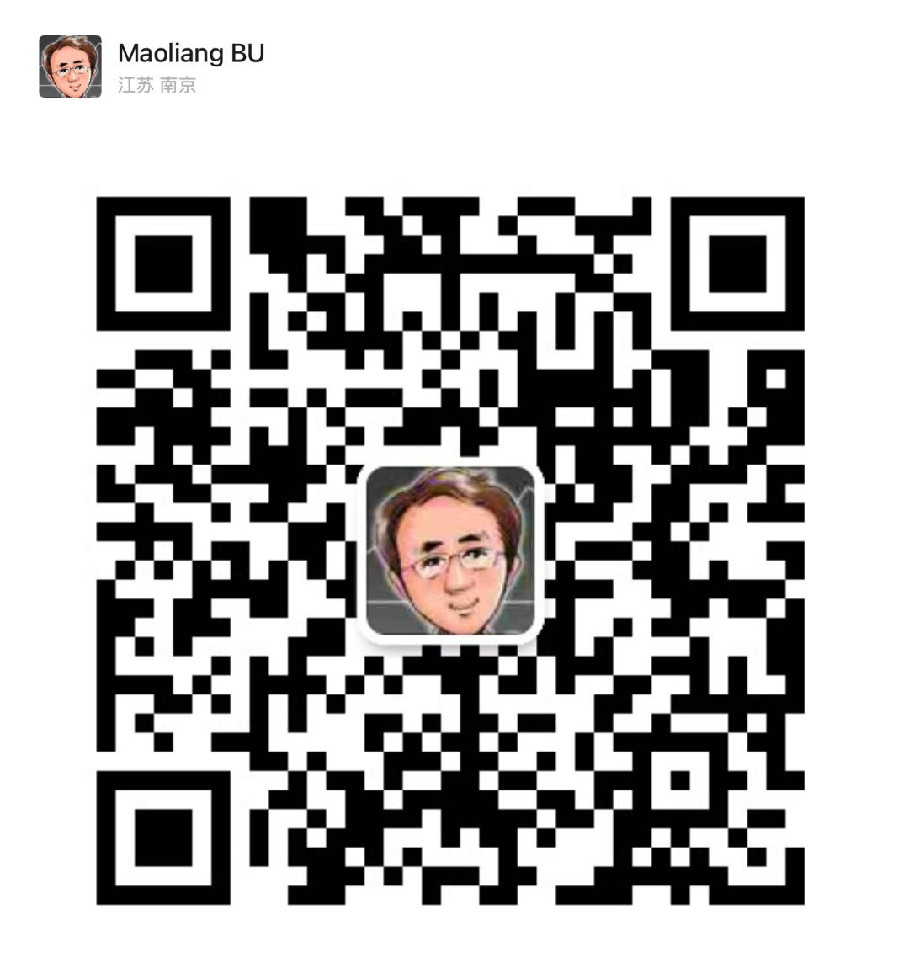
Prof. BU, Maoliang
Nanjing University
Hopkins-Nanjing Center
Email: mbu1@jhu.edu

